Slide 1
// SYSTEM ONLINE
> PROJECT CODENAME:
ECHO_SAFE
// PROTOCOL:
// UNIT:
Zero-Trace Offline Intelligence
Team Zero Gravity
// MISSION:
// STATUS:
Neutralizing Cloud Surveillance
Deployed / Offline
SECURE ARCHITECTURE BRIEFING
[CLASSIFIED]

Slide 2
// THREAT ANALYSIS
The Threat Landscape
The Adversary: Stalkerware
Data Leakage Vector
In domestic violence scenarios, abusers frequently monitor router logs, DNS queries, and cloud backups to track victims. This surveillance infrastructure creates a digital prison where every online action is visible to the perpetrator.
VICTIM
User Device
The Vulnerability
DATA
LEAKAGE
Standard AI systems (ChatGPT/Gemini) require an internet handshake. Querying "how to record evidence of abuse" sends a packet through the monitored router. If this packet is logged, it can trigger immediate retaliation from the abuser.
MONITOR
Router/Cloud
The Critical Gap
ALL QUERIES LOGGED
There is currently zero way to access intelligent legal or psychological aid in a high-surveillance household without leaving a digital footprint. This leaves victims completely isolated from potentially life-saving information.
CONNECTIVITY IS
NOT A FEATURE
IT IS A VULNERABILITY

Slide 3
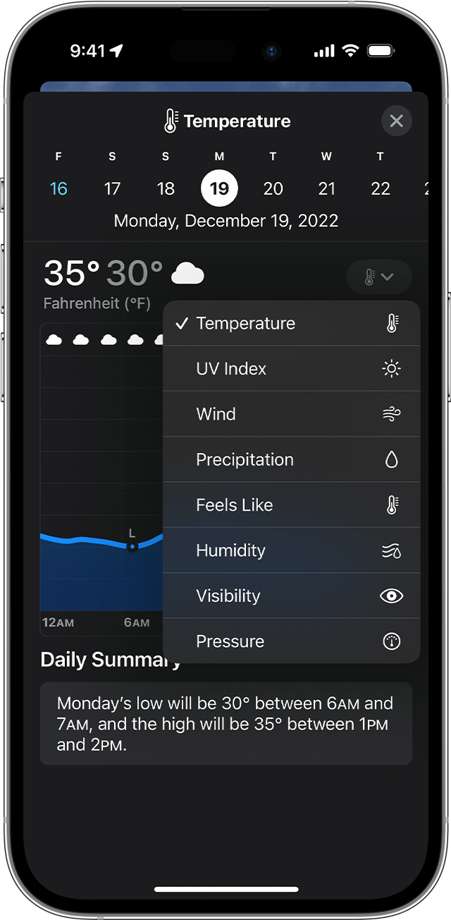
// SOLUTION ARCHITECTURE
The Trojan Horse
01
Facade Layer
02
Injection Vector
EcoWeather
ONLINE
A fully functional, open-source Weather Application that pulls local barometer data to appear completely legitimate to any observer.
The secure AI environment is only accessible via a specific "Safe Sequence" (e.g., tapping humidity 3 times + PIN).
EcoWeather Interface
Covert Activation
03
Payload Activation
Once unlocked, the device cuts all network radios via software-level firewall and spins up the Local LLM Core, creating a complete air gap.
WiFi OFF
Cell OFF
LLM ON
Zero-Trust Architecture
The app assumes the network is compromised and never attempts to phone home.
TAP HUMIDITY 3X + PIN
EchoSafe Command
SECURE
$ echo "Is Oregon a one-party consent state?"
Analyzing local statutes...
→ YES. ORS 165.540 permits recording with one-party consent.
$ █
// STEALTH METRICS
Network Traffic:
0 KB
Firewall Status:
ACTIVE
LLM Core:
RUNNING

Slide 4
// FIELD OPERATIONS
Operational Scenario
Subject Profile: "Jane"
Three-Phase Activation
Jane lives in a hostile environment with 24/7 router monitoring by her abuser. Every device connection is logged and scrutinized, making traditional help-seeking extremely dangerous.
High-Surveillance Household
STEP 1
Concealment
Trigger Event
Jane opens "EcoWeather" to check the forecast, appearing completely normal to any observer.
An escalation in verbal aggression occurs. Jane needs to know if she can legally record the argument in her state as evidence for a protection order.
Evidence Gathering Question
PUBLIC INTERFACE
Resolution
Jane queries the offline DeepSeek model: "Is Oregon a one-party consent state?" The AI retrieves the answer from the local vector store. No packets left the device. Jane is informed and safe.
STEP 2
Activation
She inputs the covert safe sequence. The interface shifts to EchoSafe Command.
SECURE MODE
STEP 3
Protection
Jane queries the offline AI and receives legal guidance with zero network footprint.
AIR-GAPPED

Slide 5
// AI ARCHITECTURE
The Neural Core
Why Dual Models? Specialized quantization for specialized tasks.
The Strategist
The Companion
DeepSeek-R1-Distill-Qwen-1.5B
Llama-3-8B 4-bit Quantized
Role: Legal Reasoning
Role: Emotional Support
DeepSeek demonstrates superior chain-of-thought (CoT) reasoning compared to Llama in logic benchmarks. We leverage this to parse complex, pre-loaded legal PDFs (RAG) to ensure victims receive accurate, non-hallucinated legal protocols .
Llama 3 exhibits higher linguistic nuance and empathy. Used when sentiment analysis detects high anxiety/distress in the user's input, providing crucial emotional de-escalation.
Capabilities
Capabilities
▸
Emotional de-escalation & grounding
▸
Statute analysis & precedent retrieval
▸
Private journaling & thought organization
▸
Safety planning & risk assessment
▸
Crisis coping strategies
▸
Evidence documentation protocols
LOGIC PROCESSING
EMPATHY PROCESSING
// STRATEGIST METRICS
// COMPANION METRICS
// TOTAL FOOTPRINT
1.5B parameters | RAG-enabled | Legal PDF corpus
8B parameters | 4-bit quantized | Sentiment analysis
~4.2GB storage | <6GB RAM | <50MB idle

Slide 6

// SYSTEM ARCHITECTURE
Zero-Trust Design
Isolation Layer
The Privacy Gate ensures that once Secure Mode is active, all API calls to the OS Network Stack are nullified, creating a complete air gap.
Hybrid Inference
The Orchestrator evaluates query intent and routes to the optimal model:
→
Logic queries → DeepSeek (RAG-enabled)
→
Comfort queries → Llama (empathy)
The Vault
All interaction logs and audio evidence are hashed and stored in SQLCipher (AES-256), accessible only via the user's biometric key.
// SECURITY METRICS
Encryption:
AES-256
Key Derivation:
PBKDF2
Access Control:
Biometric
HOSTILE ENVIRONMENT
DEVICE BOUNDARY
VAULT LAYER
Network Monitored
Air-Gapped
AES-256 Encrypted

Slide 7
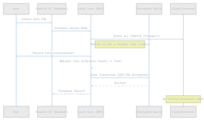
// TRANSACTION ANALYSIS
Data Sequence Flow
Demonstrating the invisible nature of the secure transaction. Zero network packets transmitted during the entire process.
1
Covert Activation
User enters safe sequence via the weather app UI, which signals the local core to initiate secure mode.
2
Network Severance
The firewall immediately blocks all traffic, creating an air-gapped environment.
3
Local Inference
Audio is processed by the on-device Whisper model. No data leaves the device.
4
Encrypted Storage
The transcript is hashed and stored in SQLCipher with AES-256 encryption.
ZERO DETECTION
Network Monitor: 0KB Traffic

Slide 8
// IMPLEMENTATION ANALYSIS
Technical Feasibility
Model Compression
Battery Optimization
Tech Stack
GGUF 4-bit Quantization
Intelligent Power Management
Implementation Framework
Utilizing GGUF (GPT-Generated Unified Format) with 4-bit quantization (Q4_K_M) dramatically reduces storage requirements while maintaining model performance.
The LLM remains dormant by default. A lightweight VAD (Voice Activity Detection) engine (Silero) runs continuously, consuming minimal resources.
React Native
Cross-platform UI framework enabling single codebase deployment to both iOS and Android.
VAD Engine
LLM Activation
Original Size
Quantized Size
<50MB
ON
Executorch
16GB
4.2GB
RAM Usage
Demand Only
PyTorch's on-device inference engine for efficient neural network execution.
74% REDUCTION
The heavy LLM only initializes when VAD detects specific decibel spikes (shouting) or keywords, ensuring all-day battery life.
This makes the 8B parameter model runnable on devices with 6GB-8GB RAM, standard for mid-range Android/iOS devices.
SQLite
Lightweight, serverless database with SQLCipher extension for encryption.
Mid-Range Device Compatibility
All-Day Battery Life
Runs efficiently on devices with 6GB+ RAM, 8GB+ storage, and modern ARM processors (ARM64-v8a).
VAD engine consumes minimal power. LLM activation only on demand, preserving battery for emergency use.

Slide 9
// SECURITY PROTOCOLS
The Kill Switch
Shake-to-Mask
Duress PIN
Anti-Forensics
Accelerometer Trigger
Plausible Deniability
Digital Camouflage
Using the device accelerometer, a sudden shake or face-down gesture instantly terminates the LLM process and overlays the Weather UI.
If an abuser forces the user to unlock the hidden section, entering a specific "Duress PIN" opens a decoy folder with harmless dummy data.
The encrypted database file header is obfuscated to look like a cached weather map tile.
// FILE MASQUERADE
// TRIGGER EVENTS
// DECOY CONTENTS
SUSPICIOUS:
Rapid shake motion
Weather diary entries
evidence_vault.db
Face-down placement
Calendar reminders
Power button triple-press
Vacation photos
INNOCUOUS:
CRITICAL SECURITY
map_cache.tmp
// RESPONSE TIME
<500ms
Duress PIN appears to function normally while concealing all security tools.
Process Termination
// ADDITIONAL MEASURES
App name: "EcoWeather"
No suspicious permissions
Legitimate network behavior
Plausible Deniability
Defense in Depth
Every security measure is designed to be deniable. The app appears to be a legitimate weather tool, the secure section is invisible, and the kill switch looks like normal app behavior.
Multiple layers of protection ensure that even if one measure fails, others remain active. From the shake trigger to duress PIN to anti-forensics, each layer provides redundancy.

Slide 10

// MISSION COMPLETE
> THE VERDICT
CLOUD AI
Optimizes for Convenience
Optimizes for Survival
• Always connected
• Powerful servers
• Easy access
• Vulnerable to surveillance
• Completely offline
• Zero network footprint
• Plausibly deniable
• Life-saving security
By leveraging the reasoning strengths of DeepSeek and the efficiency of on-device quantization, we create a safety tool that does not compromise the user's physical security for digital utility.
100%
0KB
24/7
Offline Operation
Network Footprint
Protection
> MISSION STATUS
READY FOR ARCHITECTURE REVIEW
TEAM ZERO GRAVITY
[END OF BRIEFING]

